Slide 1
Blogging application
SIMRITA JAYASIMHA 01FB16ECS384
SK SAQLAIN MUSTAQ 01FB16ECS388
SUMAIR AHMED SHARIFF 01FB16ECS399
HARSHVARDHAN SUROLIA 01FB16ECS408
T H SANJANA 01FB16ECS414
V S MEGHANA 01FB16ECS426

Slide 2
Benefits of blogging
manage online identity and build trust
learn new things
Become proficient in a new language
Get technical knowledge
Connect with new communities
Over the last decade, blogging has evolved from having more personal to more professional goals. Instead of individuals solely blogging for their friends and family, blogging began to encompass professionals blogging for the public to promote their personal brand and their business

Slide 3

Intended Audience
Bloggers: The person who writes the blog, it includes food bloggers, travel bloggers, tech forums etc.
Viewers: Viewer can like, share or comment about a blog.
Stakeholders

Slide 4
Project Scope
The software’s purpose is to create a blogging platform where users can create blog posts belonging to a specific category. The software gives freedom to the user in terms of choosing the template of the page, or the layout and design of the text in the page. Users can also attach images and videos in their posts. The system will constantly feed users with the latest blogs uploaded by a creator, if the user has subscribed to a specific creator or a category. A user can upvote/down-vote a blog post, add comments and also participate in blog discussions. All users have to login to the system before using the application.
The objective is to satisfy user requirements in terms of available features. The goals consist of enabling good user interface, easy navigation and operation, and scalability.

Slide 5
Functional Requirements
Uploading Blog
View Blogs
Like Blogs
Dislike Blogs
Browsing through blogs
Subscribe to a creator/category
Creator of a blog can re-edit the blog
Recommend blogs to users.

Slide 6
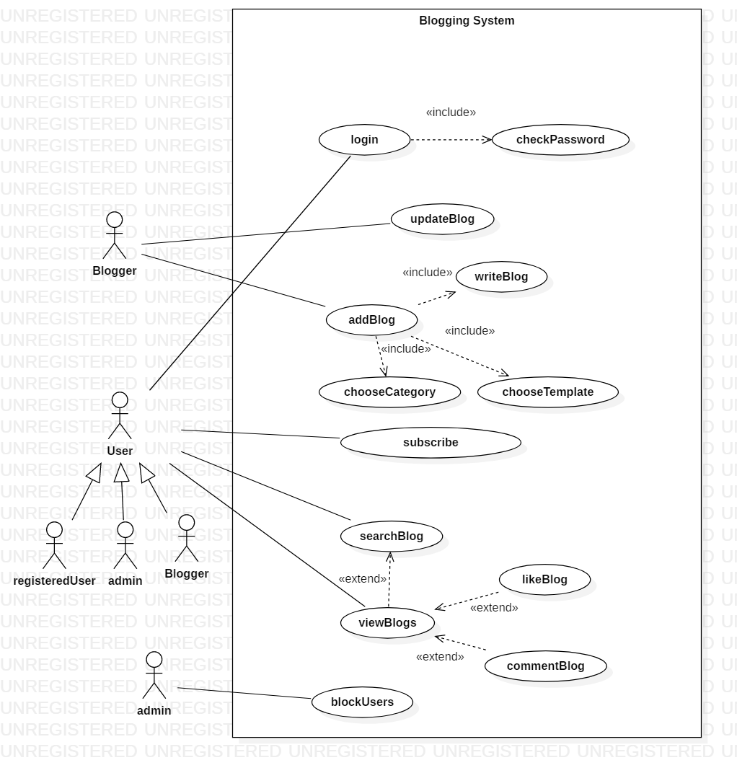

Slide 7
Non Functional Requirements
Performance requirements
Response Time: 95% of all visible pages for users respond in 12 seconds or less
The software must support at least 4000 user interactions in a day
The software shall be capable of supporting at least 200000 customers when implemented in a suitable production environment
Safety Requirements
Data replications must be made in case of loss through some scenarios
Security Requirements
Access permissions for the system information may only be changed by the system’s data administrators
Software Quality Attributes
The database roll back should happen when any update failure occurs
The interface must be simple and intuitive to use without need of instructions
Attempts made my user to successfully complete task of publishing a post must be <4

Slide 8
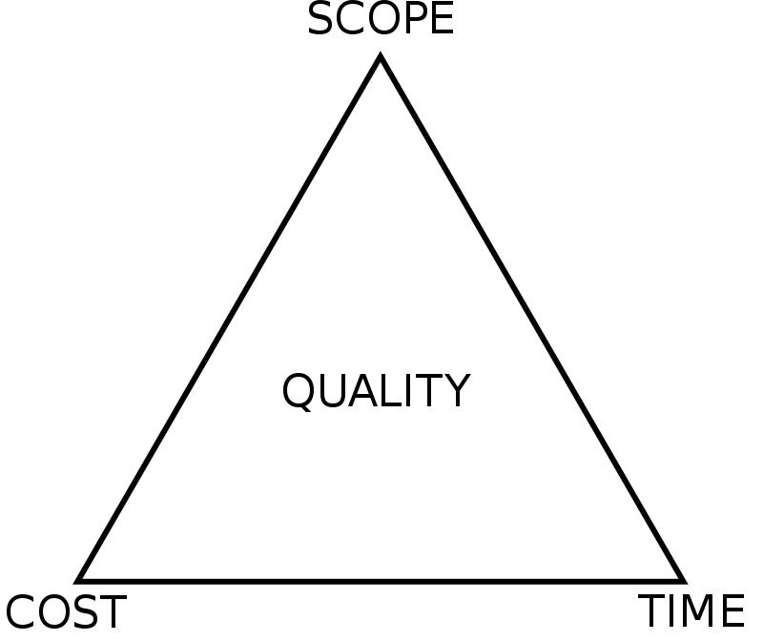
Project Management Triangle
Project Management involves ensuring the project gets accomplished on time and covers the required scope of the project mean while keeping the cost variable.
Notes:
Cost is variable because to maintain scalability cloud resources.

Slide 9

SDLC Model
SCRUM Model is proposed to be used to developed the software as the
project has a small team size and also almost all the features clearly recognized, and each feature can easily be ranked and based on that work can be carried out.
And also as each feature is developed it can be easily tested and also documented.
Notes:
Since most of the cost will be covered in making the system HA and Scalable ,thus using scrum ensures that atleast the development cost is controlled.s

Slide 10
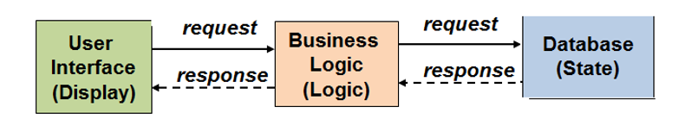
Architecture
3 Tier Architecture-
State-Logic-Display is a three tier architectural pattern where
The client (user interface), business layer and the database are separated
The clients access business functionalities through a user “display.”
The business functionalities are provided through the “logic "part
The data store keeps all the persistent data or “states, "usually in a DB
In this pattern, the client would never access the data storage directly

Slide 11
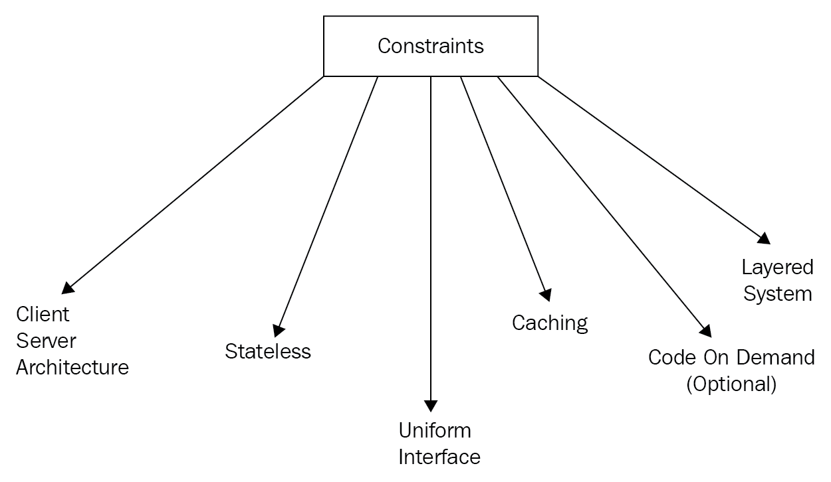
Software Design
REST style of programming is used to implement the software ,
Representational State Transfer (REST) is an style that defines a set of constraints for creating web APIs
Client-server
Statelessness
Caching
Layered System
Uniform interfaces
Notes:
Layered System->a client can not necessarily tell if it is directly communicating with the server or an intermediate (proxy).
Caching->Stateless client-server communication can increase server load since some information may have to be transferred several times so requests that only retrieve data should be cache-able

Slide 12
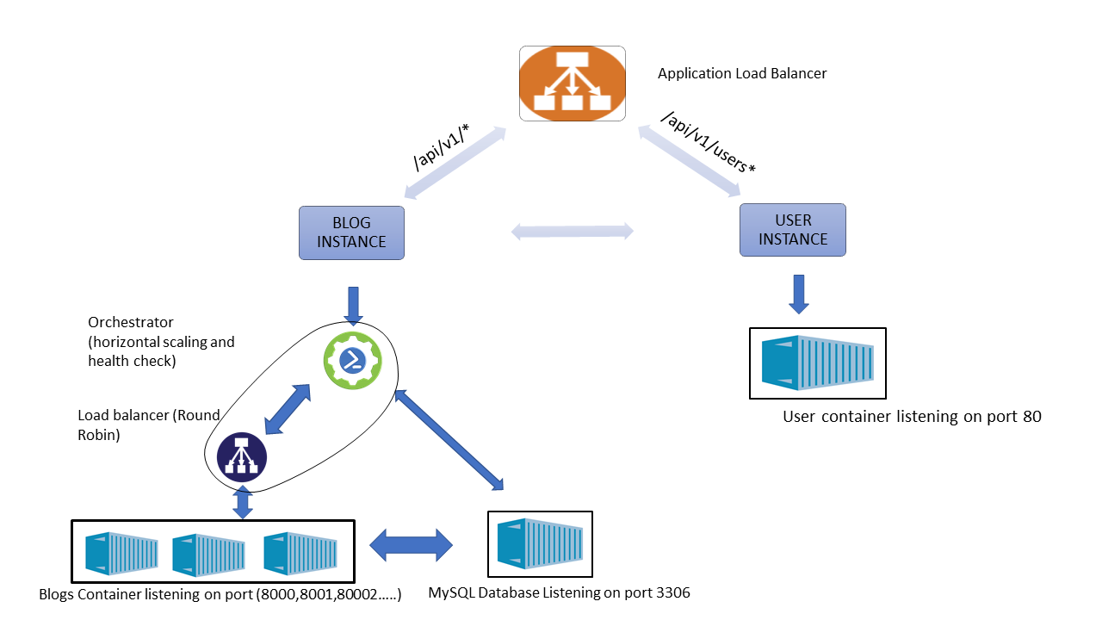
Overall System Architecture

Slide 13



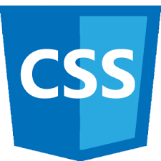
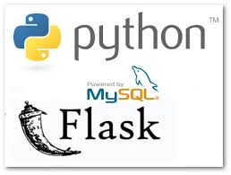
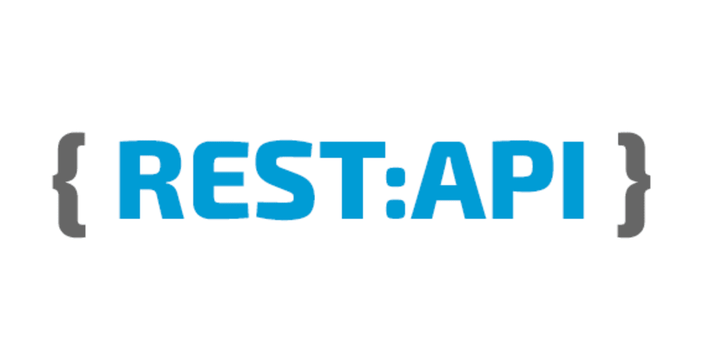
Tools used
Inorder to develop the front-end HTML , JavaScript , CSS is used along with AJAX Patterns such as Long polling to fetch updated data from backend Multi-Stage Download to make the entire interface work fluidly.
The back-end is implemented using Python and Flask is used to implement the API’s which the interface is going to use.
MySQL database is used to store user information along with all the blogs and the related data.
Since REST is used the server will not maintain any state, so each user who is using the system will maintain there state respectively and the state information is stored in the local Storage of the browser.

Slide 14
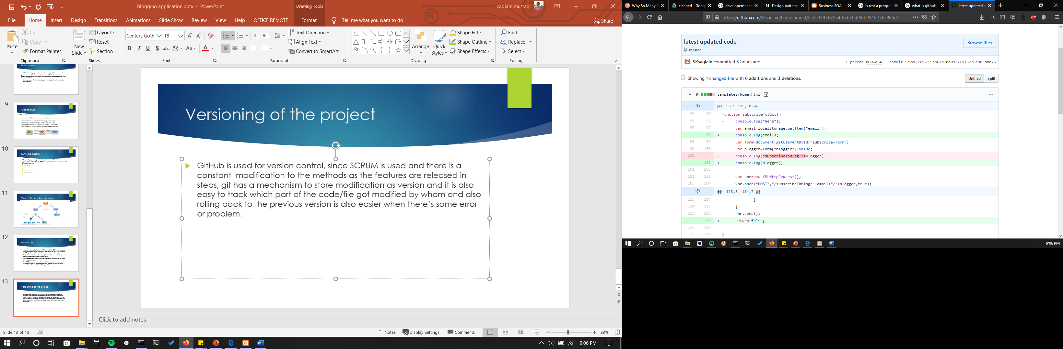
Versioning of the project
GitHub is used for version control, since SCRUM is used and there is a constant modification to the methods as the features are released in steps, git has a mechanism to store modification as version and it is also easy to track which part of the code/file got modified by whom and also rolling back to the previous version is also easier when there’s some error or problem.

Slide 15

Testing
Dynamic test is used to asses the working of the component
During unit testing and integration testing Postman tool is used.
In-order to test the API’s and backend code, we have used postman
Postman is a app for interacting with HTTP APIs. It has a friendly GUI for constructing requests and reading responses.
Every browser comes with a JavaScript Debugger which enables you to step through JavaScript code and examine or modify its state to help track down bugs.
For System testing regression testing is used and manual assessment of the whole system behavior is done to check for proper functionality as well as whether the software meets all the function and non-functional requirements

Slide 16
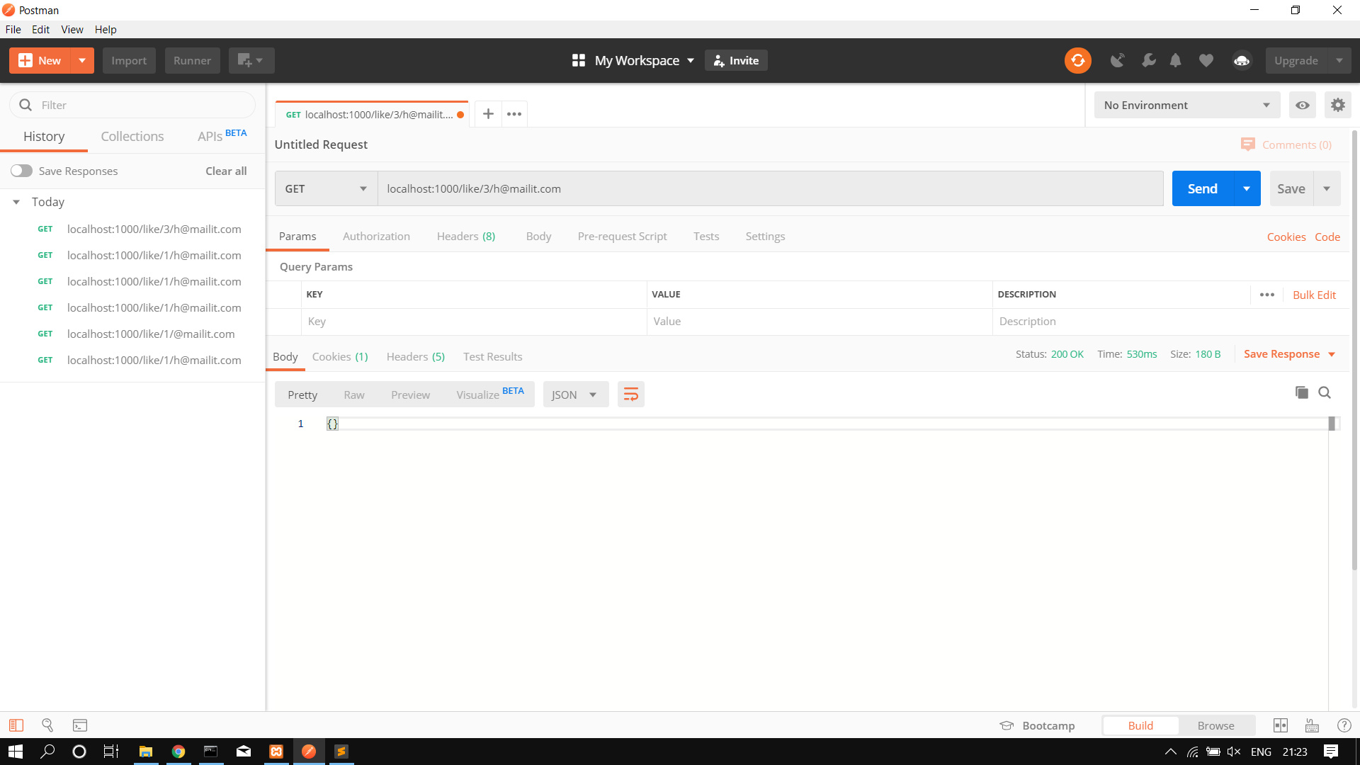

Slide 17
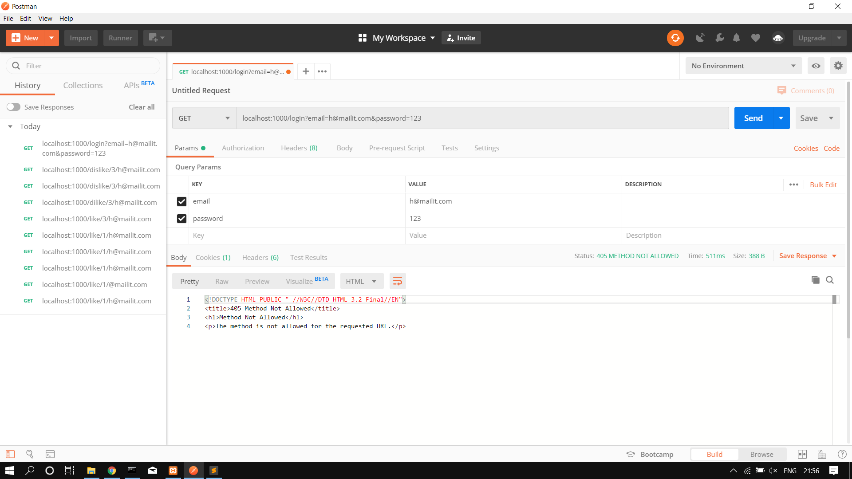

Slide 18
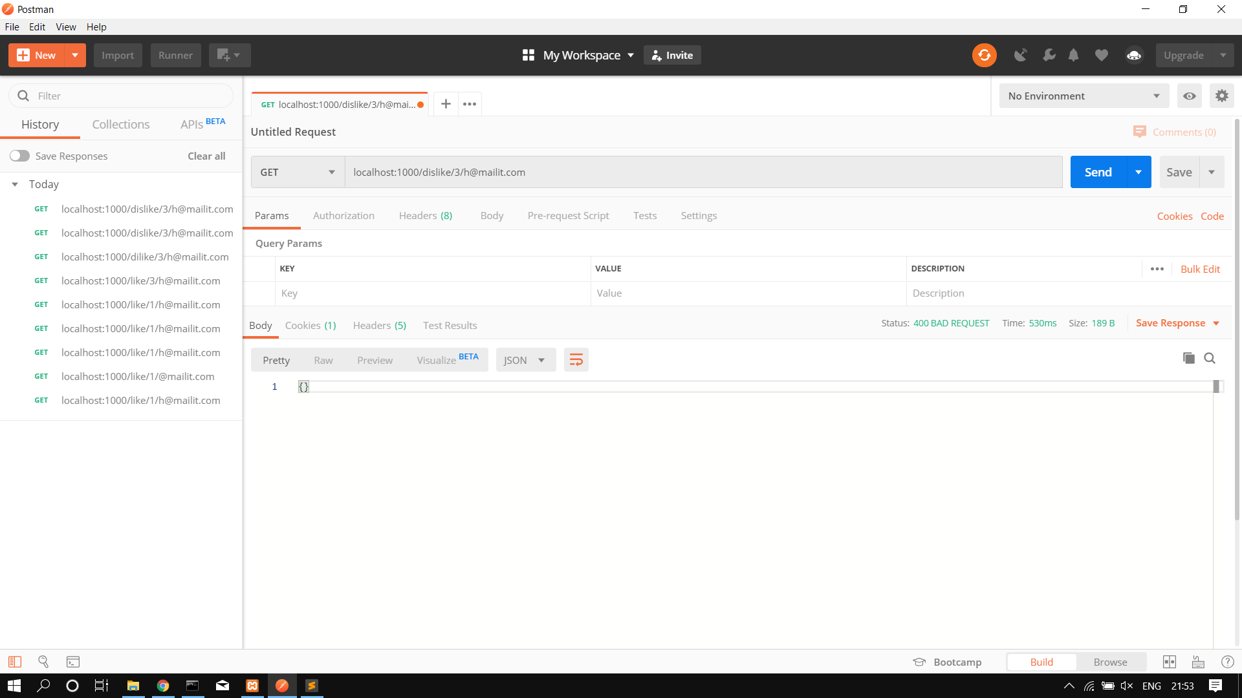

Slide 19
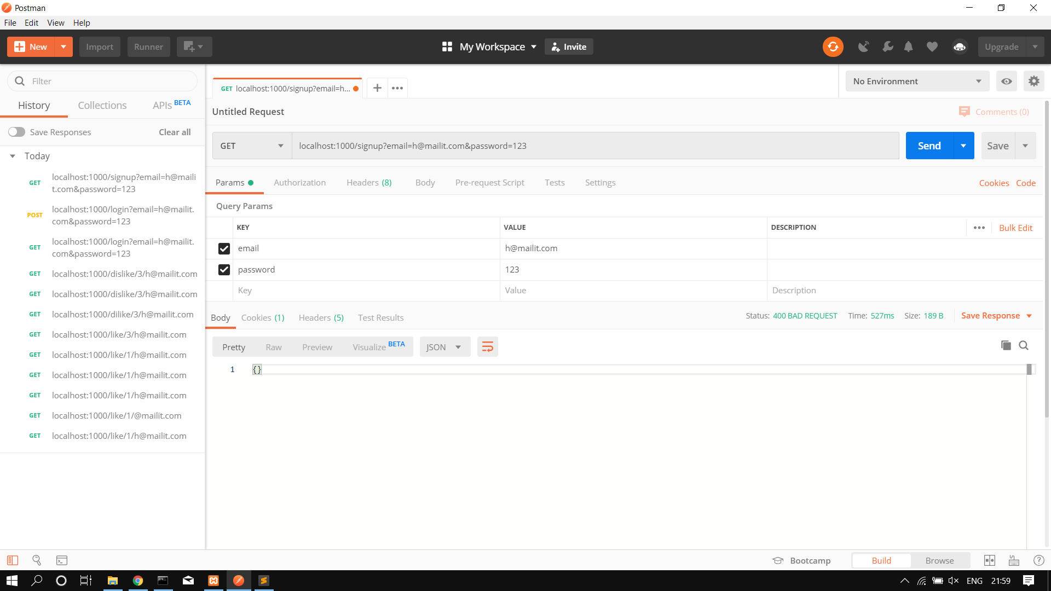

Slide 20
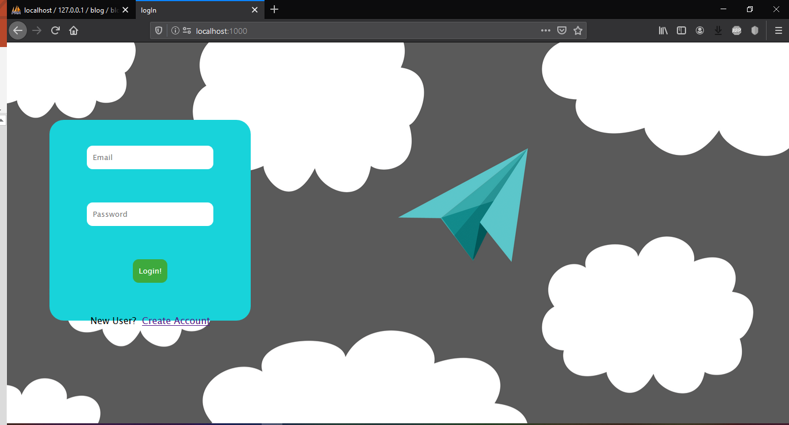
Interface

Slide 21
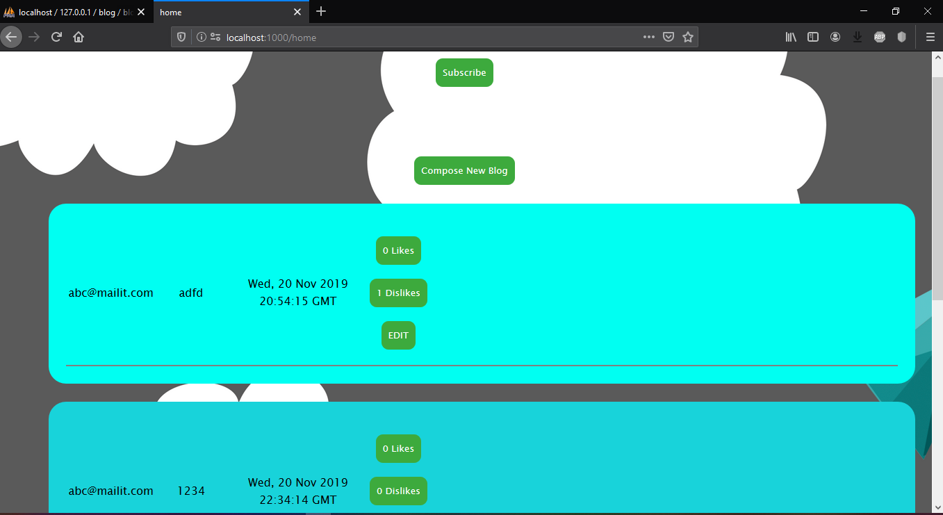

Slide 22
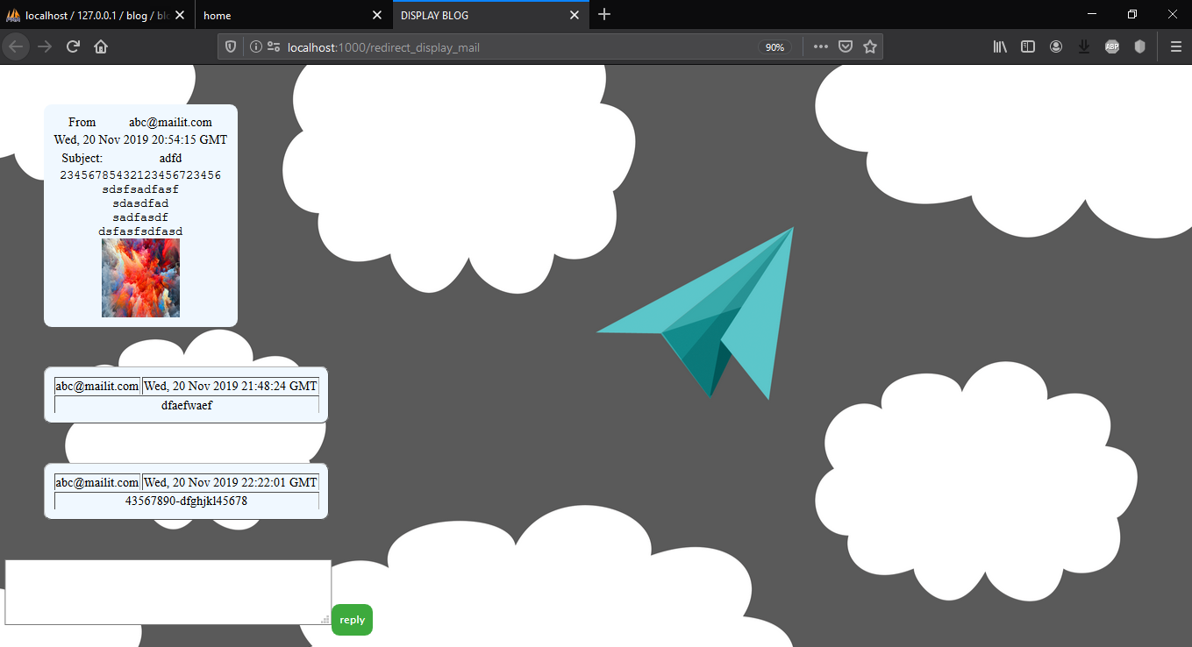

Slide 23
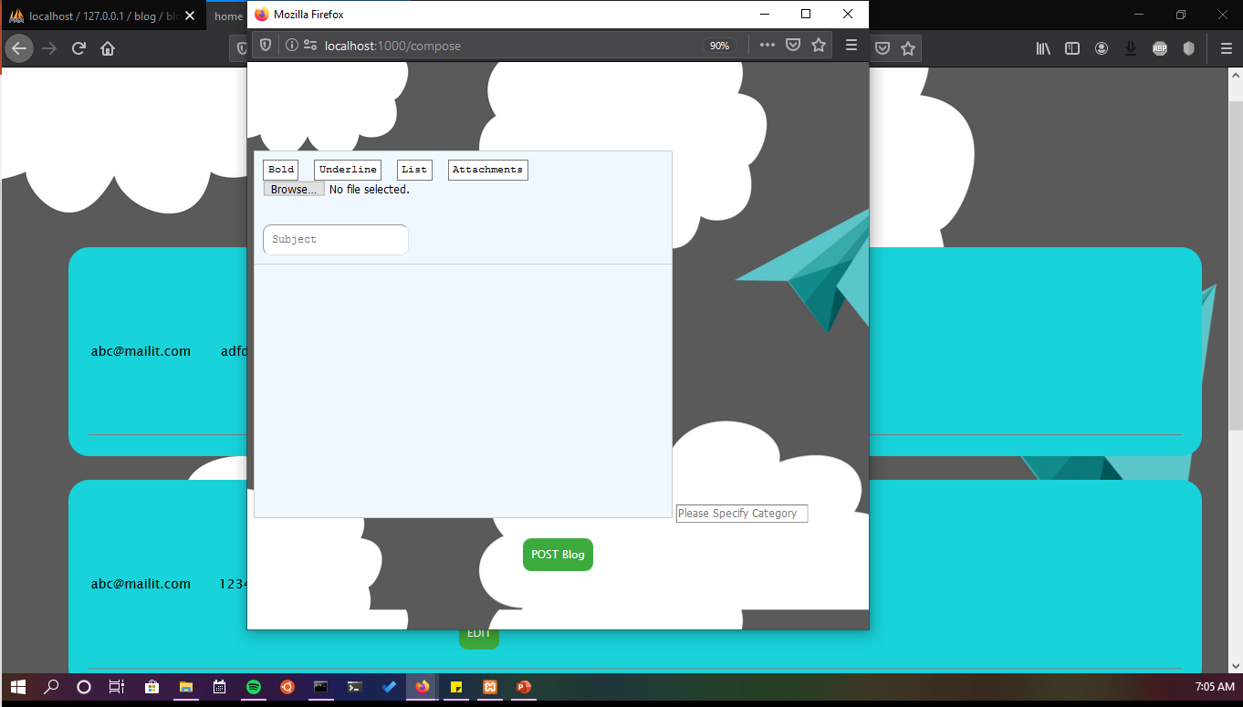

Slide 24
Future improvements
We are constantly taking feedbacks form the user so that existing features can be modified if there’s any bug and also new so that new features can be introduced.

Slide 25
Thankyou

